Slide 1
Advancing AI/ML in Retail: A Comparative Analysis of SARIMA and Linear Regression for Sales Prediction
Final Thesis
Jun 9th, 2024

Slide 2
Student Name : Richard Kanagaraj Samuel
Course Name : LJMU Masters in ML and AI – Oct/2023
Student ID : 1109800
Project Name: Advancing AI/ML in Retail: A Comparative Analysis of SARIMA and Linear Regression for Sales Prediction
Thesis Supervisor Name : Dr. Ankit Bharatkumar Desai
Details
Notes:
Hello Everyone My name and Student of
Glad to present my final thesis

Slide 3
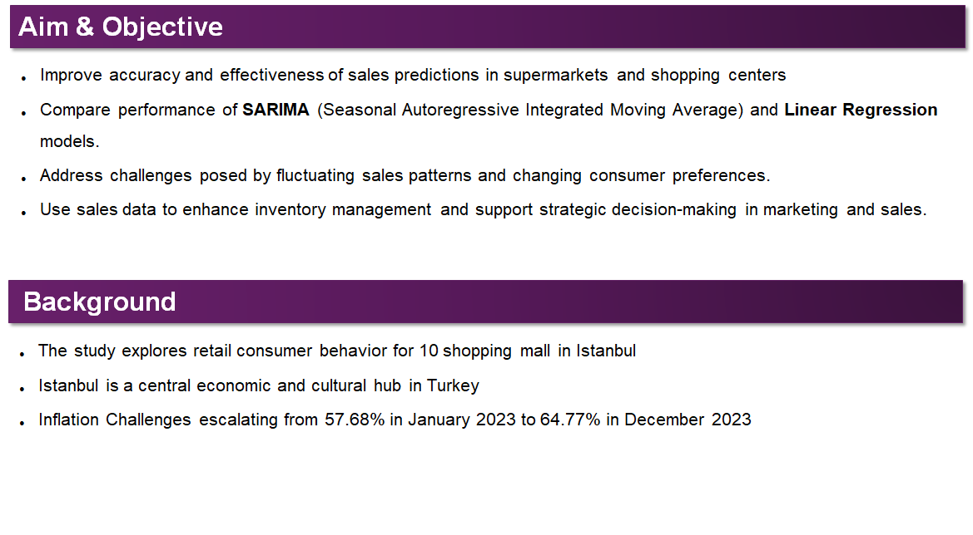
Notes:
Let's start with Aim and Objective

Slide 4
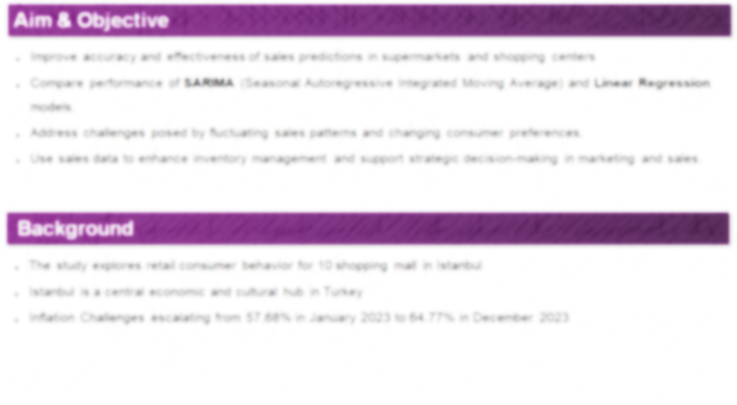
Notes:
Primary Aim of the thesis

Slide 5
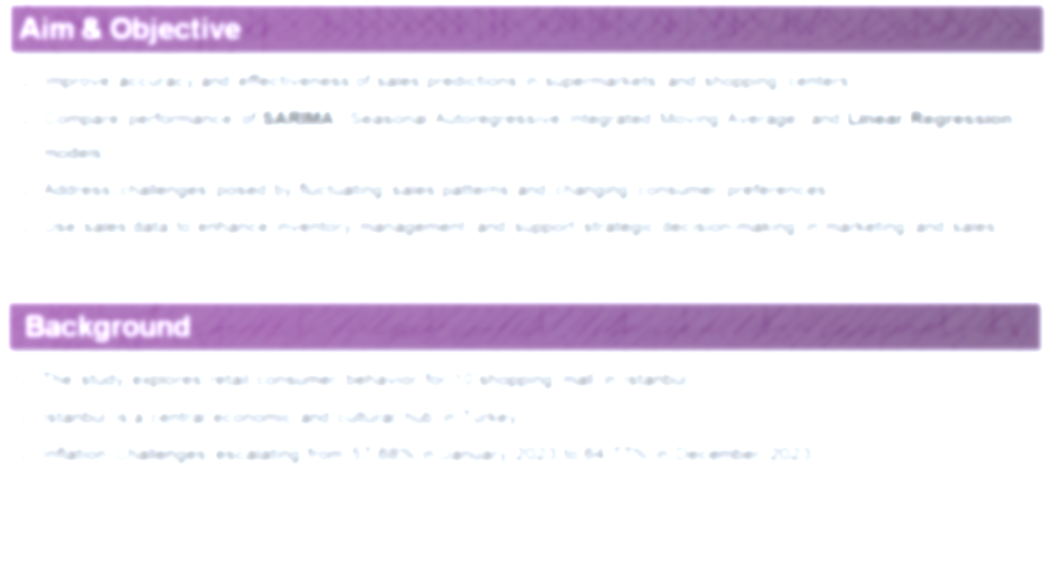
Notes:
Moving on to Back Ground
Data from www.kaggle.com
One of the major challenge country phased was inflation
7% increase and growing
Recent impact on Inflation as affected the Inventory and Marketing Spend
Primary Aim of the study is to have a better inventory management

Slide 6
Notes:
That’s the quick summary

Slide 7
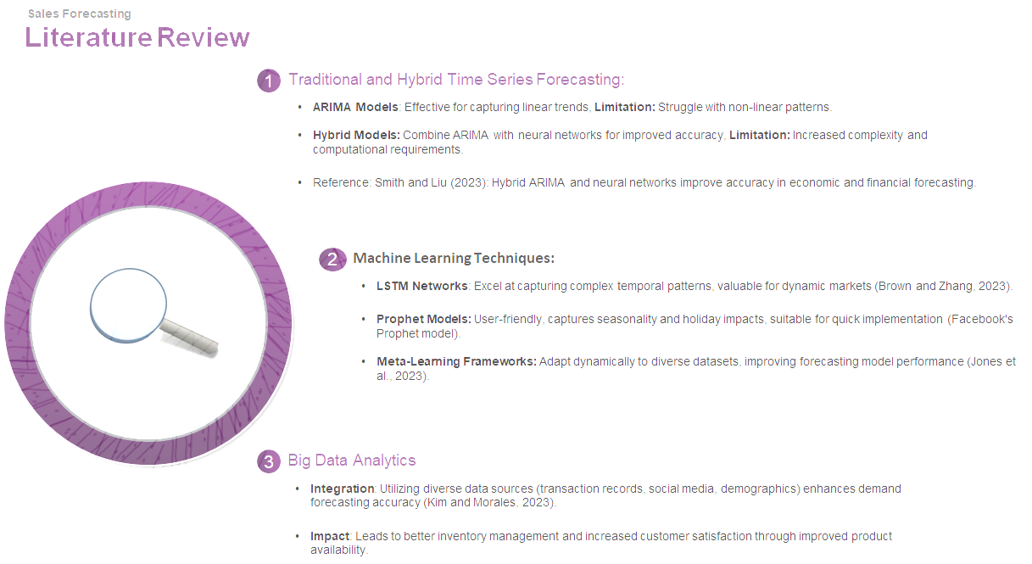
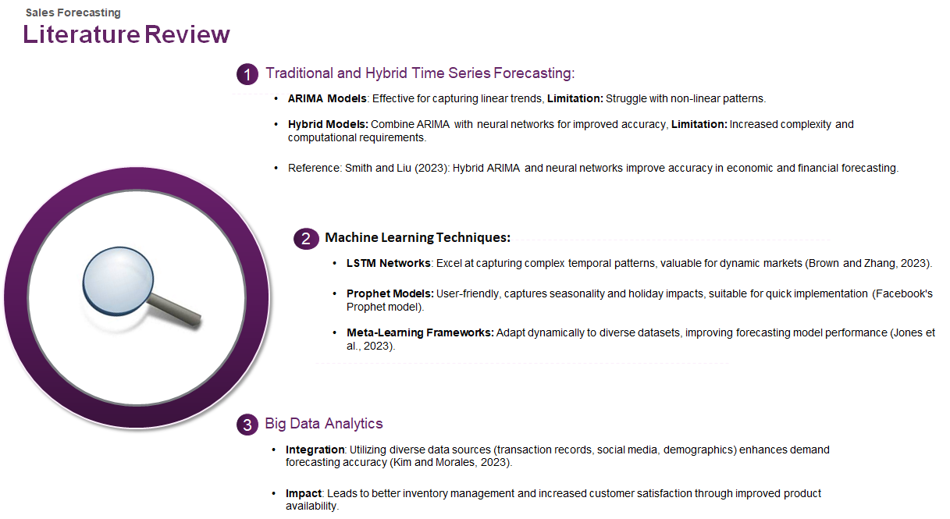
Notes:
Before we start our analysis on the data, we want to do Literature review and find what's done in the field of sales forecasting
We categorize the review by Techinque

Slide 8
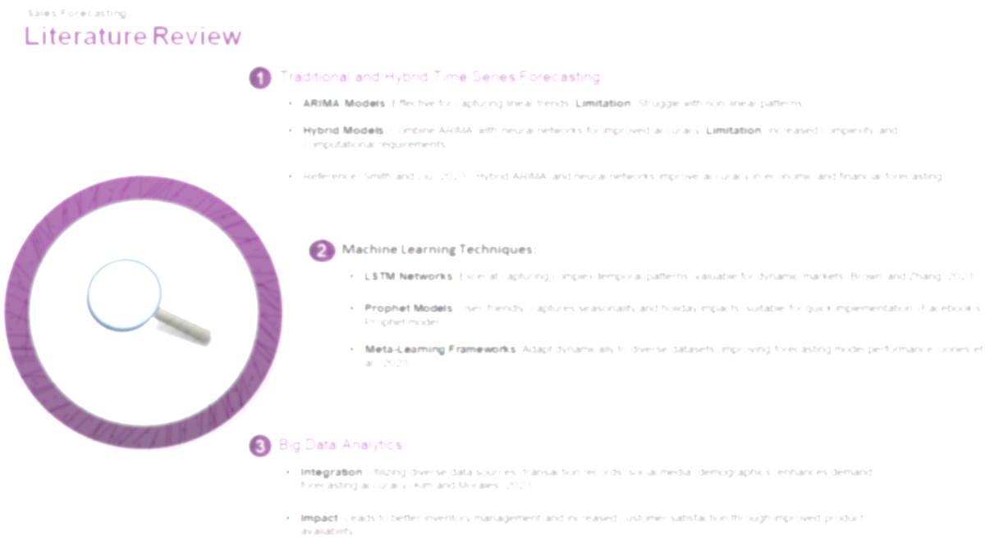
Notes:
NEURAL NETWORK

Slide 9
Notes:
Few of the researches have tried LSTM and Prophet both has improved forecast accuracy
Talk about Prophet

Slide 10
Notes:
Few Tried Big Data and the advantage of Big Data was integrating with multiple data source like ( transaction , social media , demographic ) that enchases demand forecast accuracy

Slide 11
Notes:
That’s the quick summary

Slide 12
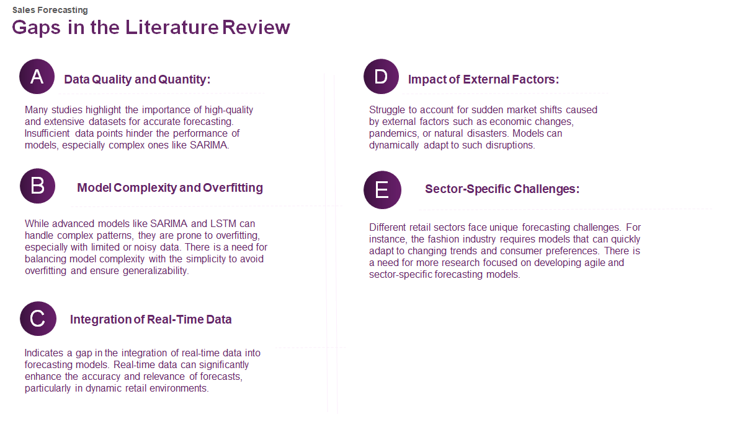
Notes:
During the literature review we found few Gaps in the review, and we will go one my One

Slide 13

Notes:
Data Set was used not huge
Next Gap we found was on

Slide 15
Notes:
Next Gap we found was on Integrating with Real time data
Many study was done without using real time data that had significant impact in accuracy of forecast when deployed

Slide 16
Notes:
Next gap we found was on external Factors gap like Pandemic or Natural disasters that’s impacting the model performance when occurs which model cant handle

Slide 17
Notes:
Sector Specific challenges pause
Fashion industry phase a unique challenge because changing trend and customer preference
Needed research just focused on developing agile / sector specific forecasting

Slide 18
Notes:
That’s the quick summary of the Gaps in Literature Review. all these gaps helps us focus on building a simpler model and build the model based on data character not based on model feature

Slide 19
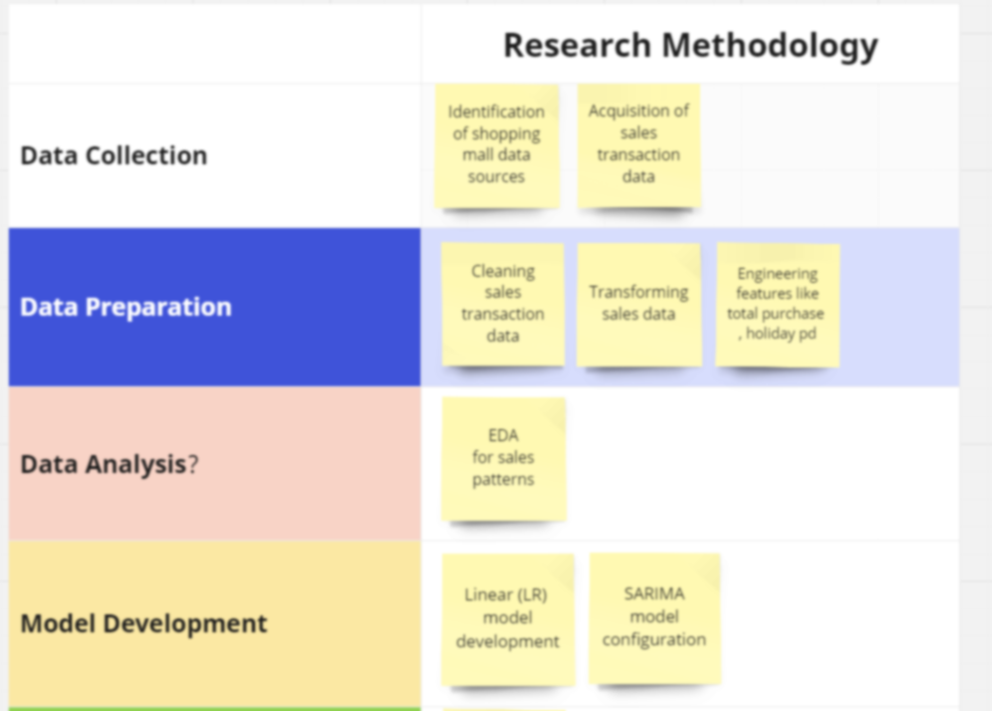

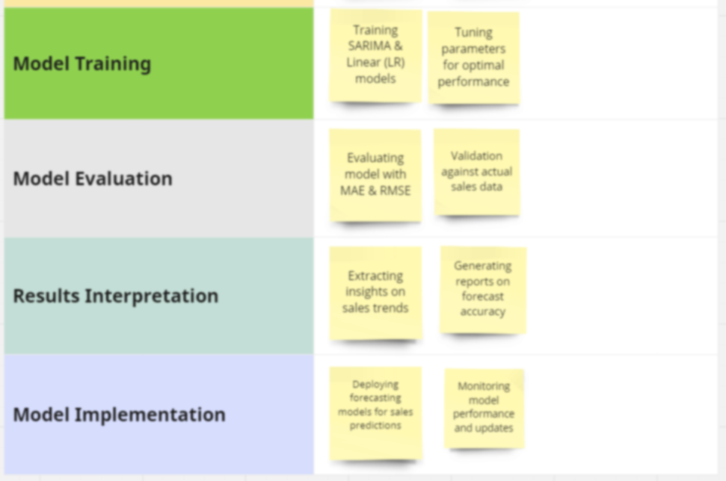
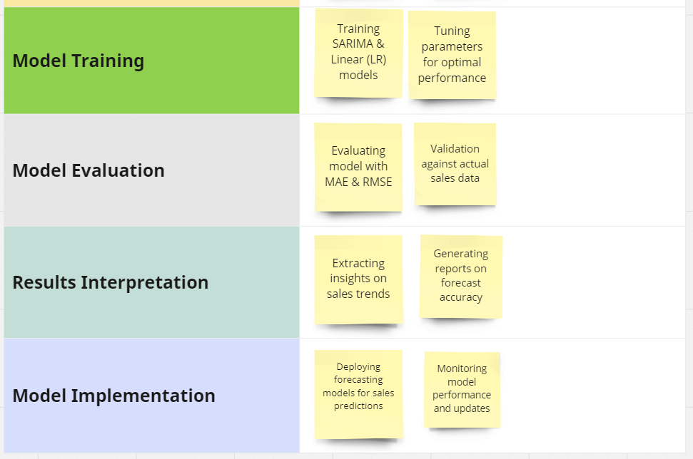

Research Methodology
Sales Forecasting
Notes:
Slow down
We set up our research Methodology in below order

Slide 20


Release Methodology
Sales Forecasting
Notes:
We started of with Data collection, we received the data for Kaggle
Next step is Data preparation …

Slide 21
Research Methodology
Sales Forecasting
Notes:
Next step is to move and start analysis the data

Slide 22
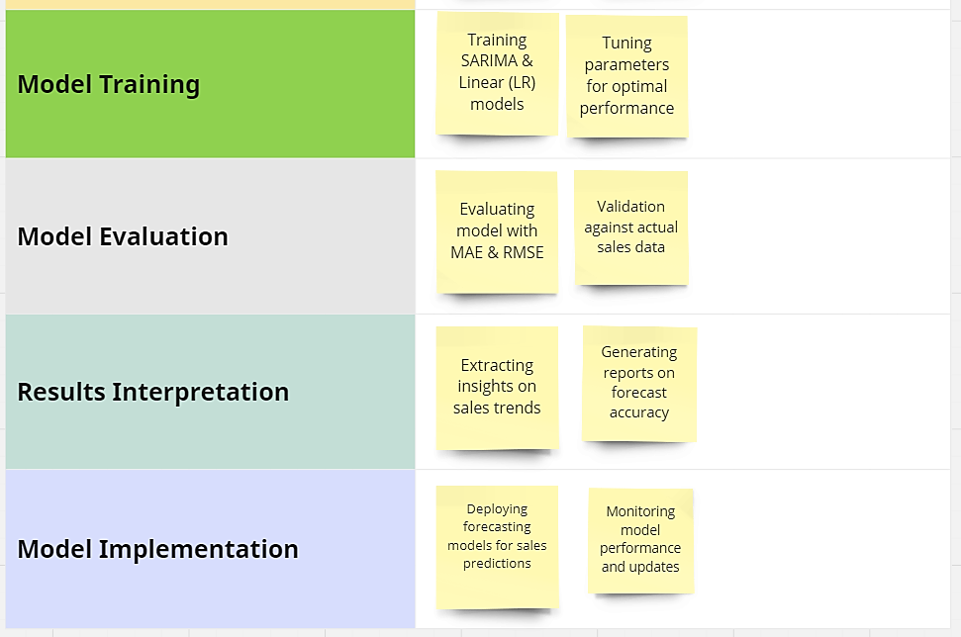

Research Methodology
Sales Forecasting
Notes:
Split the data into Train and Test Data Set with 80 20 rule split
Module evolution will be done based on values from MAE , MSE and R2

Slide 23
Research Methodology
Sales Forecasting

Slide 24
Research Methodology
Sales Forecasting

Slide 25
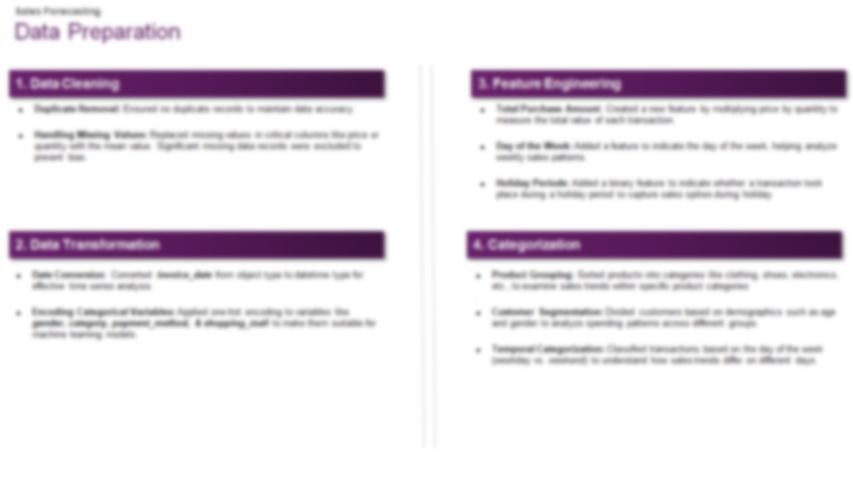
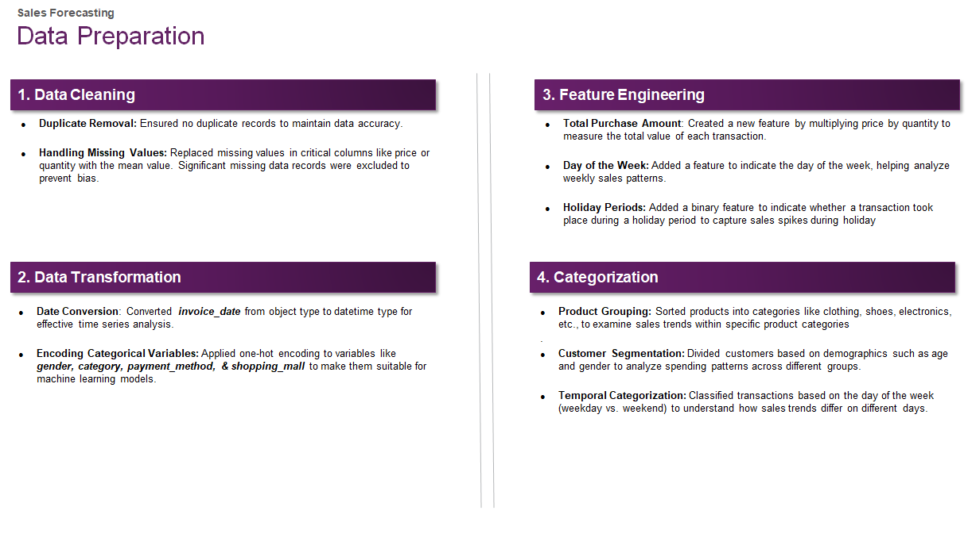
Notes:
In our research methodology first we started data Preparation

Slide 26
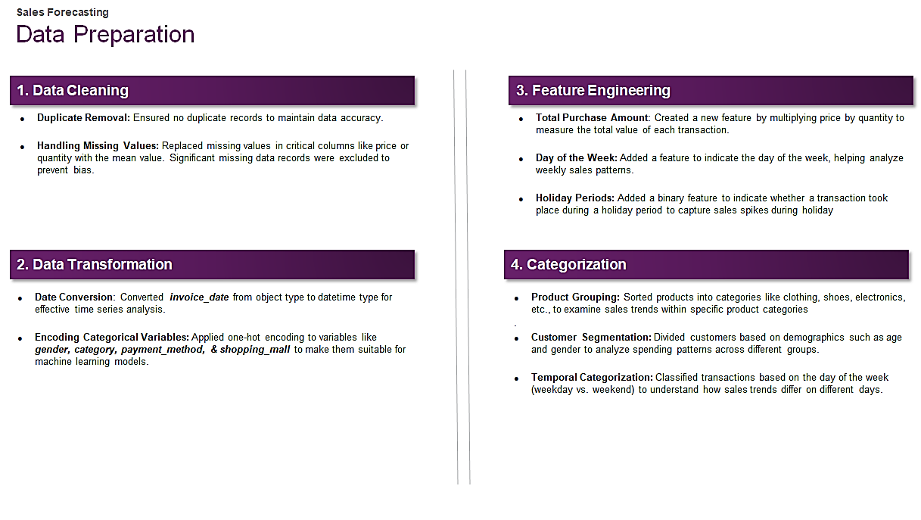
Notes:
We performed

Slide 27
Notes:
We moved our focus on Data Transfomation

Slide 28
Notes:
Move to Feature Engineering and introduced below feature
Total Purchase Amount:- Created new feature by multiplying Qty X Price
Data of the week help analyze weekly sales patterns
Holiday periods help capture the spikes during holiday

Slide 29
Notes:
We move and started categoration of data

Slide 31
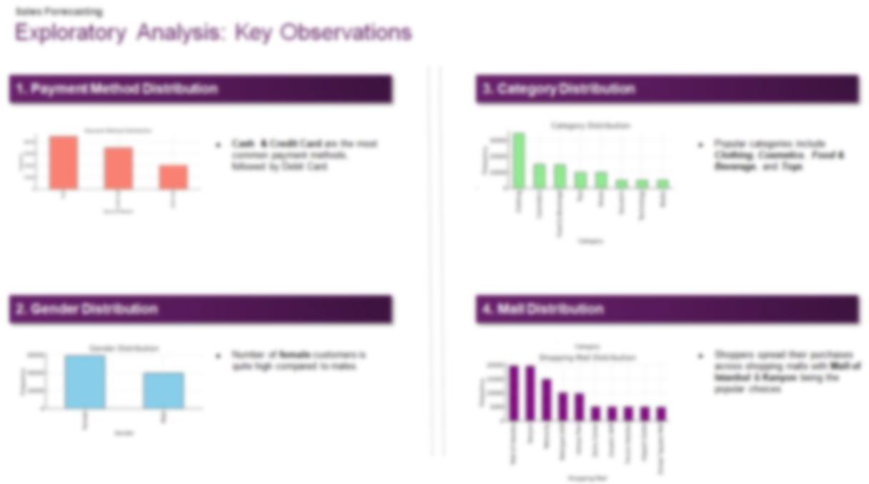

Notes:
Once the data preparation is done we performed a detail EDA and below insights were generated

Slide 32
Notes:
We learned cash is used more than credit card

Slide 33
Notes:
We moved to Gender Distribution

Slide 34
Notes:
We move our focus to see how the category is distributed , we found Clothing had the biggest spend followed by cosmetics & Food and Beverage
Thought technology was much more

Slide 35
Notes:
we moved our attention to mall distribution More sales could be because of the location

Slide 36
Notes:
pause

Slide 37
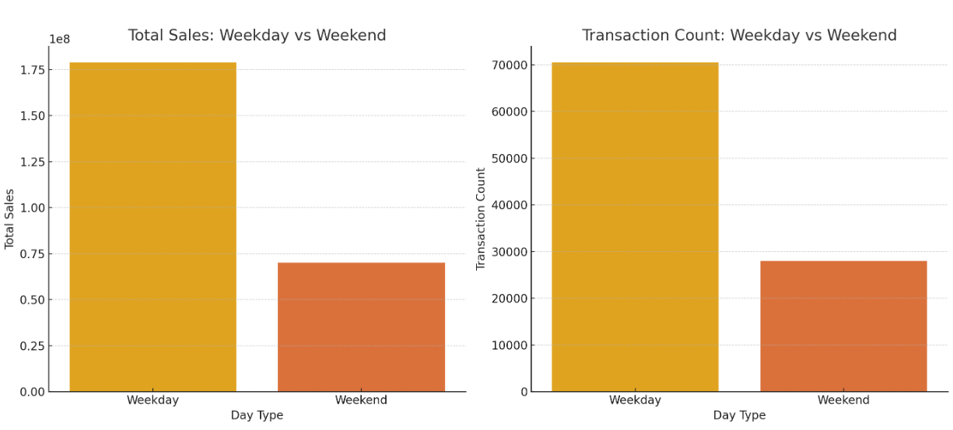
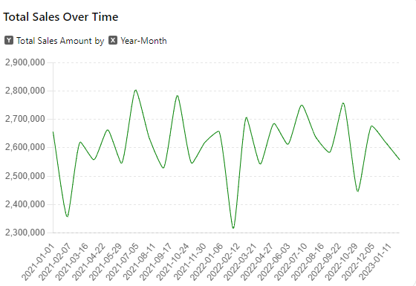
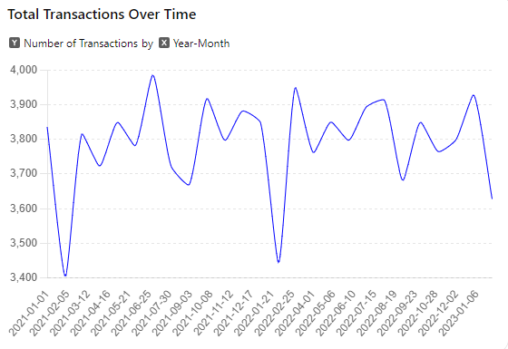
Exploratory Analysis: Key Observations
Sales Forecasting
1. Trend Analysis
Noticeable ups and downs indicating variations in customer activity over different months. These variations may stem from shopping patterns, special promotions or other factors impacting consumer habits
2. Weekday vs Weekend
Weekday sales surpass weekend sales, These findings indicate that most sales and transactions take place on weekdays. This data can be valuable, for planning marketing strategies and allocating resources effectively
Notes:
We moved our focus to time series analysis and we want to understand how the sales is performing overtime (increase/ decrease could be because of inflations)
We also did an analysis on weekday vs weekend

Slide 38
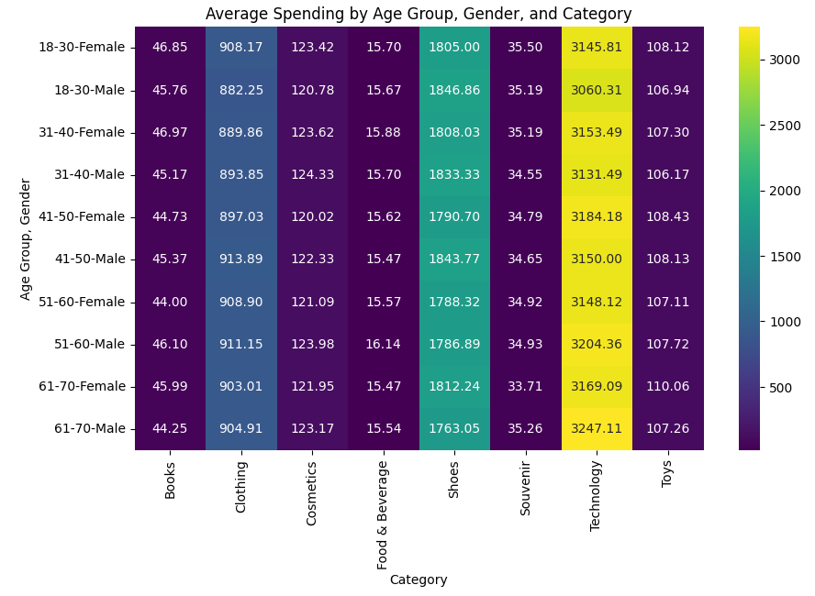
Exploratory Analysis: Key Observations
Sales Forecasting
Average Spending by Age Group, Gender and Category:
Younger age groups (18-40) tend to allocate their funds towards Technology and Shoes. On the hand older age groups (51-70) also exhibit expenditures on Technology with a slight decrease in spending on Shoes. Moreover, males generally tend to invest in high ticket items, like Technology and Shoes compared to females
Notes:
We performed heat map analysis on the spend using Age Group , Gender and Category
Below is the quick summary of all the EDA we performed, all the finding gives us Insite into how the business is performing and what business attribute needs to be focused on

Slide 39
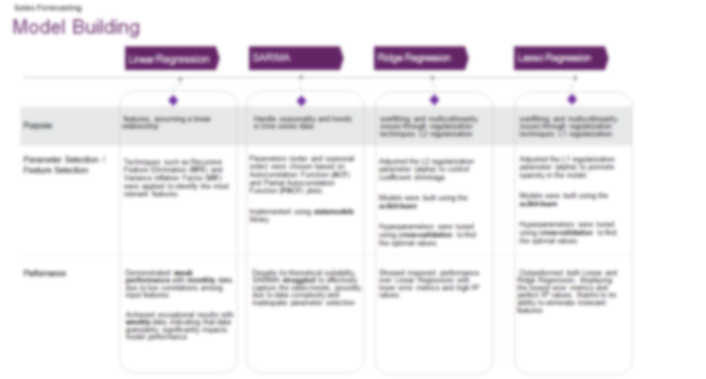

Notes:
Once the EDA is done, We moved on model building during the EDA we should the charactertic of the data that helped is keeping up the correct model that best fits the business
Linear Regression was our baseline model

Slide 40
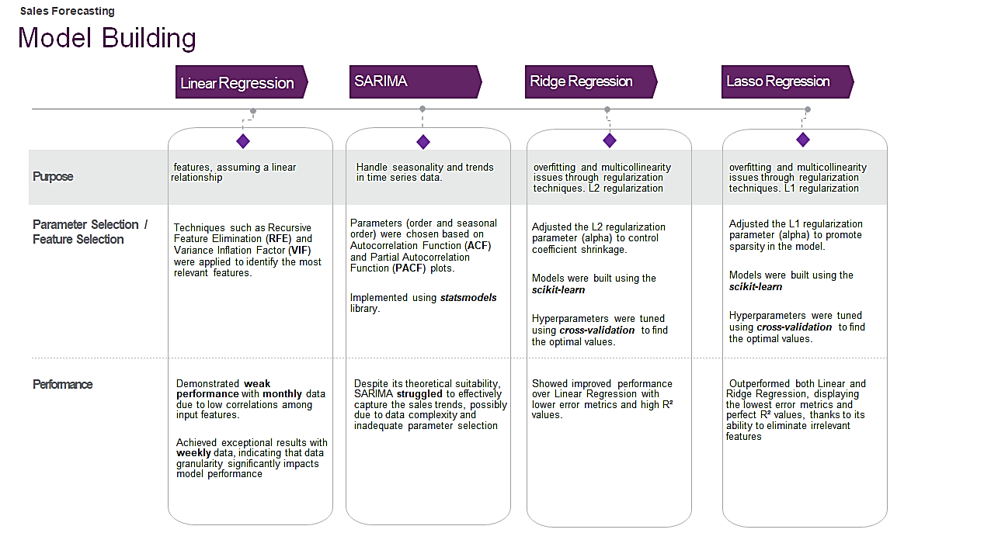
Notes:
Purpose of picking each mode

Slide 41
Notes:
On the Parameter and Feature selection
For Linear

Slide 42
Notes:
Talk about monthly and move on to weekly forecast

Slide 44
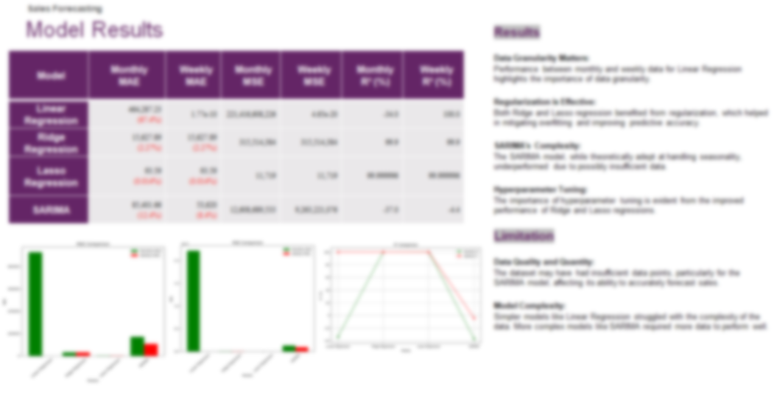

Notes:
We will go over model performance
Focus on R2

Slide 46
Notes:
Green is monthly
Red is weekly

Slide 47
Notes:
Focusing on the Results and Finding

Slide 48
Notes:
Coming back to the limitation
staring with Data Quality and Quality – Insufficient Data point has affected SARIMA Model forecast accuracy
Model complexity , Complex model does not always get the best result like SARIMA which requires more data

Slide 49
Notes:
Thanks the quick summary
Going forward in this study my recommendation is to use Lasso Regression
also compare with the previous studys we find not always complex model perform will

Slide 50
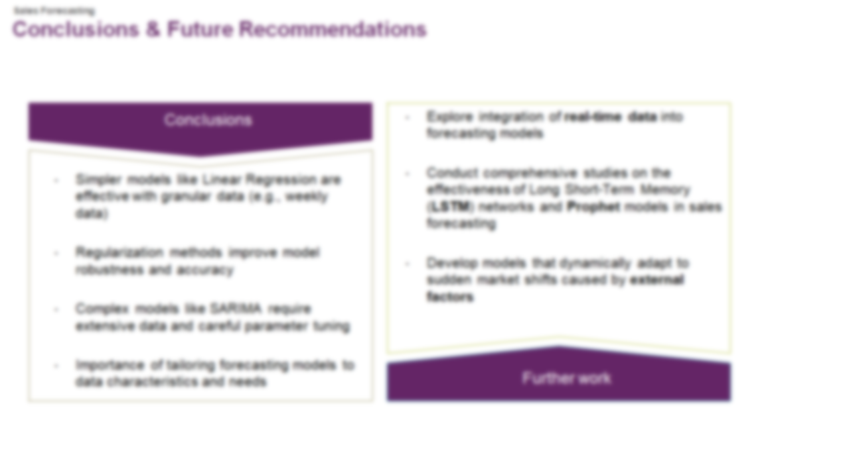

Notes:
Coming back to conclusion and Future Recommdation

Slide 51
Notes:
Thru our research the conclusion we drawn was ….
Its proven again more complex model like SARIMA
one model doesn’t fit all business forecasting need , we need to pick the model based on data characteristics and business needs and not based on model feature

Slide 52
Notes:
Some of the future work that new researchers can exploring is
Also exploring the other models like LSTM and Prophet. May focus on future work will be using Prophet to see how the forecast behaves
Include external factor in your study to see how the model adapts to dynamic shift in the market

Slide 53
Notes:
This bring to the closure of my final thesis presentation
l could like to thank my thesis supervisor Ankit Desai who helped me a lot in guiding thru this thesis journey

Slide 54
Thank you
Richard Kanagaraj Samuel
Jun 9th, 2024
Notes:
Thank you all for your time , Have a wonderful Day

Slide 55
Future Recommendations
Further work
Sales Forecasting
Invest in robust data collection and preprocessing techniques for accurate sales forecasting
Implement advanced hyperparameter tuning methods and computational resources for complex models
Emphasize the importance of data granularity, regularization, and hyperparameter tuning in training and development programs for retail analysts
Explore integration of real-time data into forecasting models
Conduct comprehensive studies on the effectiveness of Long Short-Term Memory (LSTM) networks and Prophet models in sales forecasting
Develop models that dynamically adapt to sudden market shifts caused by external factors
Practical Applications:

